Slide 1

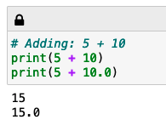
CGI: Introduction to Python
Just printing some text
Printing the result of a calculation

Slide 2
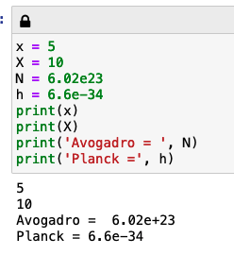
CGI: Introduction to Python
Upper/lower case matters!
Entering numbers in “E-format”
We can print multiple things together

Slide 3

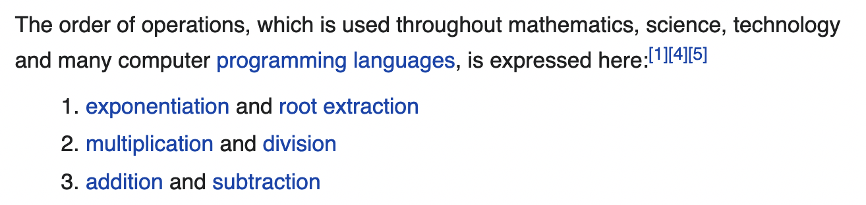
CGI: Introduction to Python
Which one of these is different from the others? (and why?)
https://en.wikipedia.org/wiki/Order_of_operations says …

Slide 4
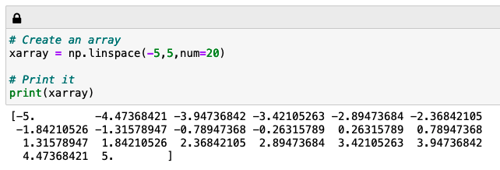
CGI: Introduction to Python
A scalar is just a single number, an array is a bunch of scalars
Numpy’s linspace function makes array-making easy
20 numbers in “xarray”

Slide 5
CGI: Introduction to Python
A variable calculated using an array is usually another array of the same length
20 numbers in “xarray”
20 numbers in “xsquared” and “rootx” too

Slide 6
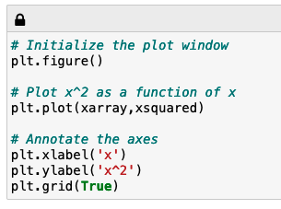
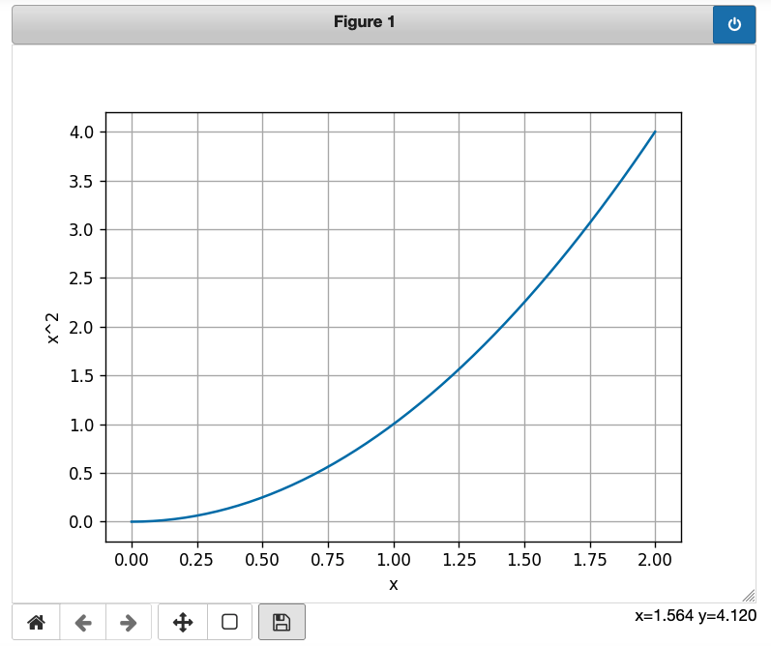
CGI: Introduction to Python
Use these to pan, zoom, and save!

Slide 7
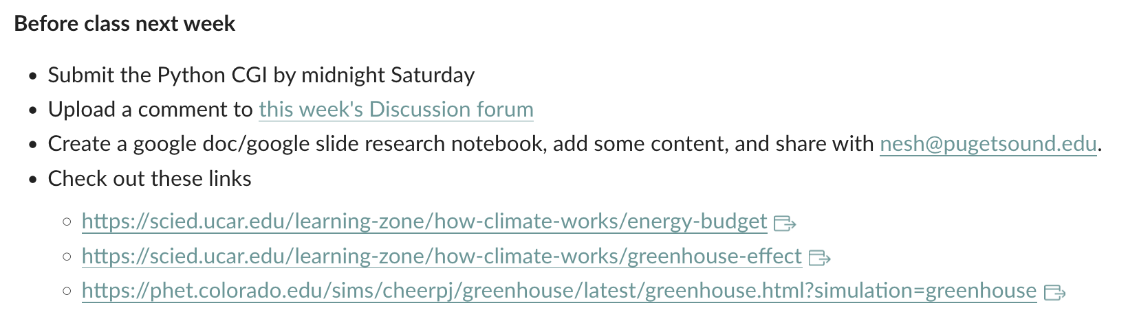
Next week: the energy budget of Planet Earth (see Canvas for links)

